Slide 1
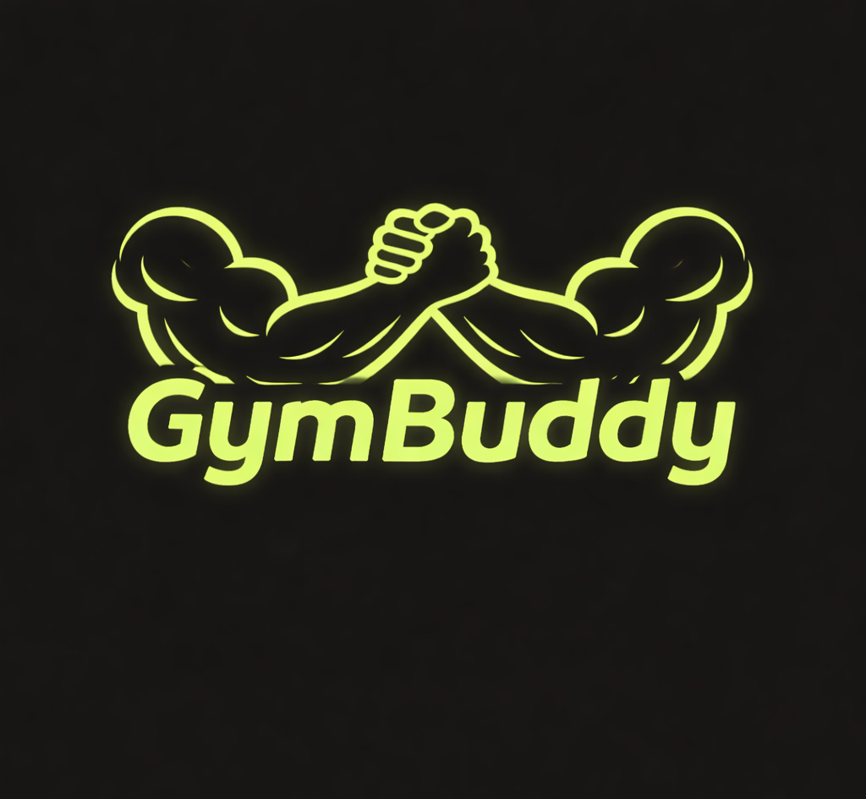
GymBuddy -Team 7

Slide 2
Why GymBuddy was made
GymBuddy was made to help out all the countless individuals who wanted to go find a gym for themselves but couldn’t make the choice because they did not have everything in front of them at once. GymBuddy takes a customer’s preferences, like location, workout style, etc., and matches them with gyms based off of those. Meanwhile, on the gym owner side, you could post your gym and information about it and hope you attract more clients.

Slide 3
Customer’s side
On the customer’s side of GymBuddy, you are able to log in or make an account where you can set your preferences, browse through available gyms, and leave reviews/replies.

Slide 4
Gym Owner’s side
On the owner side of GymBuddy, you had the ability to log in or set up an account, which then required you to make a profile, which involved location, amenities, equipment style, etc. Also, not only view reviews left on your gym but also make replies to them.

